Slide 1
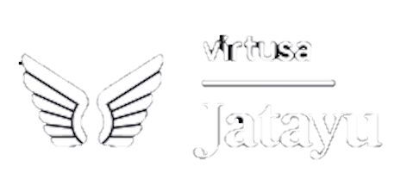
METAVERSE INTERACTION MODULE
Ideathon – Season 2
Tech W1
Ethical Squad
Muhil S
Nethaji V
Aswin O
Athul Dhanesh
MANAKULA VINAYAGAR INSTITUTE OF TECHNOLOGY

Slide 2
Metaverse!
“Metaverse” generally refers to a virtual world that lies beyond, on top of, or is an extension of the physical world.
It is a combination of multiple elements of technology, including virtual reality, augmented reality and video where users "live" within a digital universe
Today we look at the internet
But, In Future we’re going to be in a experience
23

Slide 3
Abstract
Hospital buildings usually contain sophisticated facility systems and special medical equipment, strict security requirements, and business systems. Traditional methods such as BIM(Building Information Modeling) are becoming less capable of real-time updates of building status and big data volume. By proposing innovations both in technique and management. The case has been steadily running for more than a year in the hospital and achieved desired performance by reducing energy consumption, avoiding facility faults, reducing the number of requested repairs, and enhancing the quality of daily maintenance work.
If a patient’s condition is deteriorating or there is an emergency on a certain floor, the right action can be taken in real-time to respond using the Digital Twin(DT)
It is hoped that this project will solve the problem faced in managing and maintaining the Hospital

Slide 4
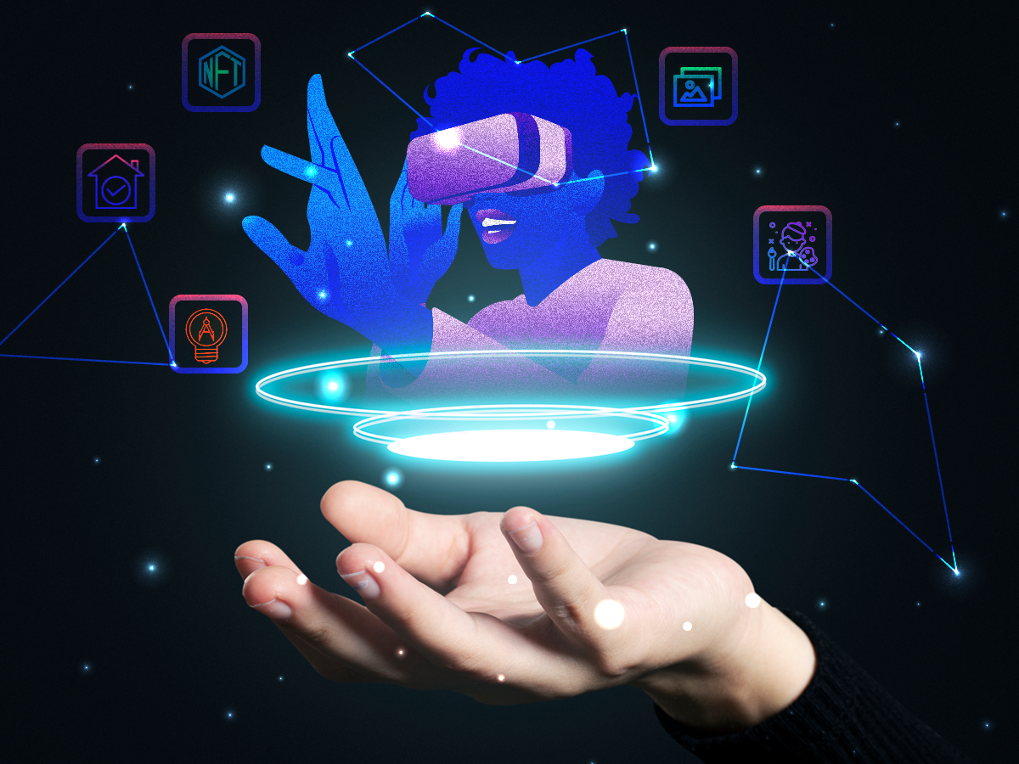
Preparing for the next evolution of the internet, let's create systems that could be put in place to make the transition from the real-world to the virtual one seamless.
"Digital Twin"
Synthetic avatars that makes use of the advancements in the field of Natural Language Processing and Graphic Rendering to represent the Marketing and Care departments of the companies within the virtual world.
Frameworks that helps monitor changes in the real world and update it's "Digital Twin" within the virtual world to facilitate better visualization and data manipulation.

Slide 5
Digital Twin
1
A Digital Twin is a real-time digital clone of a physical device

Slide 6
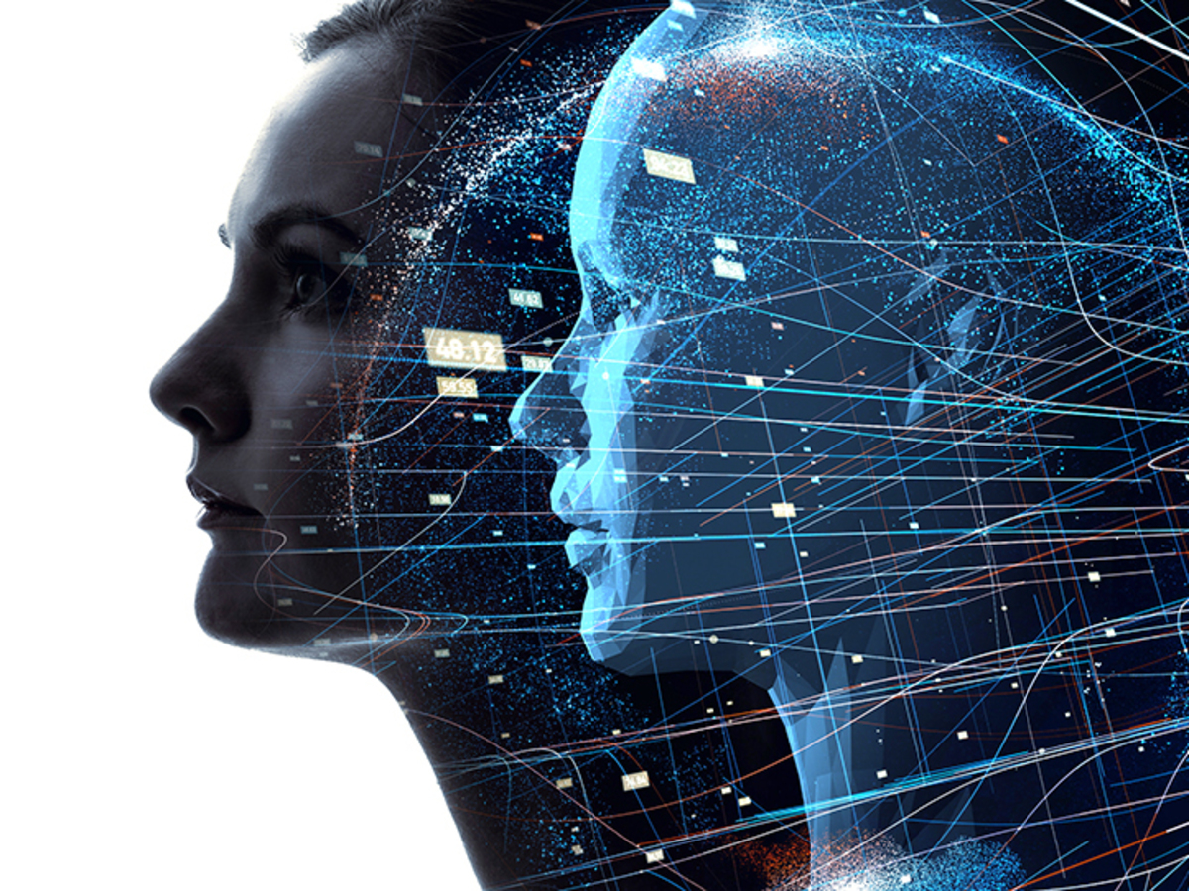
What are Digital Twins?
A digital twin is a virtual representation that serves as the real-time digital counterpart of a physical object or process.
Computer based version of anything that exist.
Updated from real-time data, and uses simulation, machine learning and reasoning to help decision-making

Slide 7
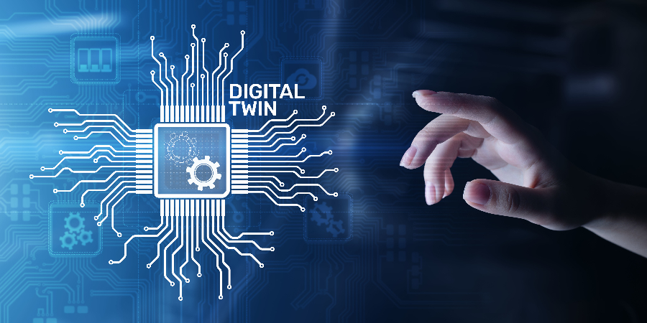
Why do we need digital twins?
A digital twin is a digital representation of a physical object, process or service.
In short, creating one can allow the enhancement of strategic technology trends, prevent costly failures in physical objects and also, by using advanced analytical, monitoring and predictive capabilities, test processes and services.
Why it is Important
Digital twins are constructed to simulate an object or process in real-time, offering performance insights and potential problems.
Value
It will make the management to understand the problem in the hospital and make it easy to understand the problem in active
7

Slide 8
Target Segment
2

Slide 9
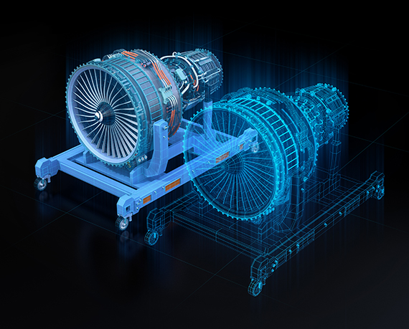
Targeted Segment
Hospitals (Prime Target)
Engineering (systems)
Automobile manufacturing.
Aircraft production.
Railcar design.
Building construction.
Manufacturing.
Power utilities , etc.,

Slide 10
3.1 $ Billion
48.2 $ Billion
58.0%
The global digital twin market size was valued
In 2020
Market Size
Growth
Reach by 2026
Expected to grow at a CAGR of
During the forecast period

Slide 11
Solution Idea
3
In a Nutshell

Slide 12
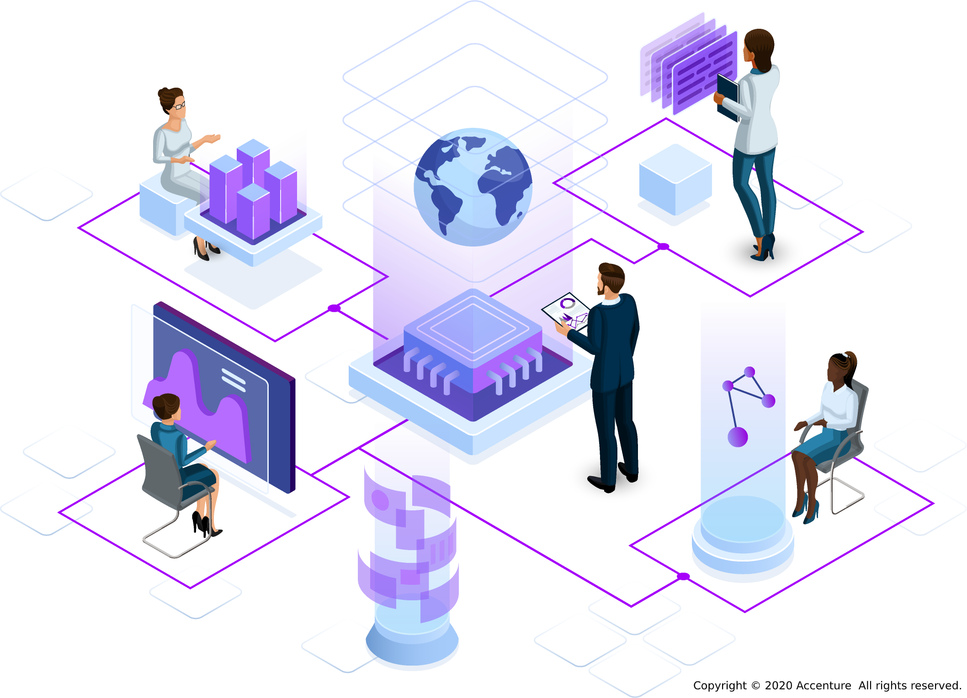
Solution Idea
Data: Data from across the entire smart hospital is needed, such as data about people, processes, connected devices, operational building systems, Hospital/Clinical Information Systems and external health systems.
Context: Context includes real-time information about the actual state of the hospital, the people within it and their interactions between each other. The key element here is capturing the current status of people, systems and things and making them more visible.
Reasoning: A method for applying reasoning to data is needed to drive action. Most commonly, reasoning is based on asynchronously processed rules, artificial intelligence (AI) or machine learning (ML) models, or temporal reasoning for varied frequency of events.
Key Performance Indicators (KPIs): KPIs are required to provide meaningful business context and to ensure alignment between hospital objectives and performance measurement.
By creating a object detection algorithm, we can detect object and using machine learning to create a digital twin And converting a real world image to Digital Twin.

Slide 13
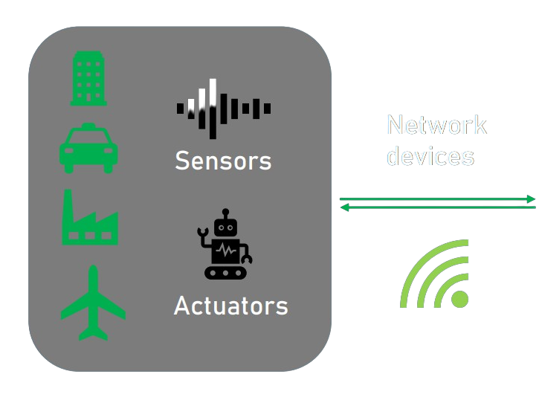
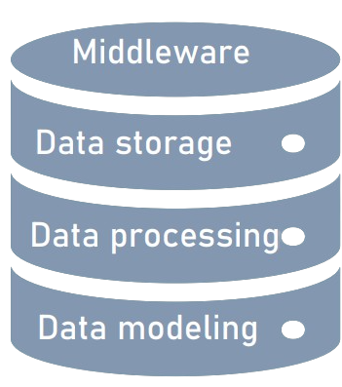
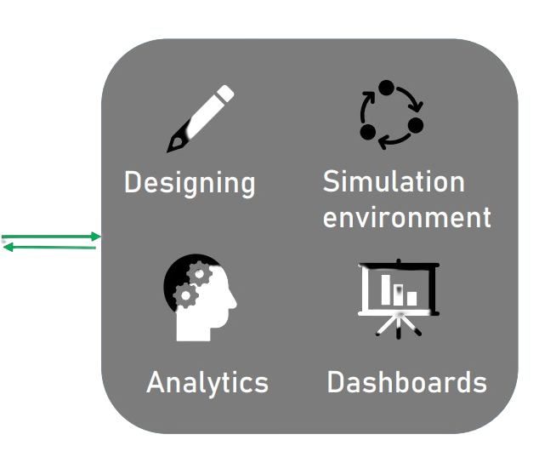
Use case Diagram
Hardware
Software

Slide 14
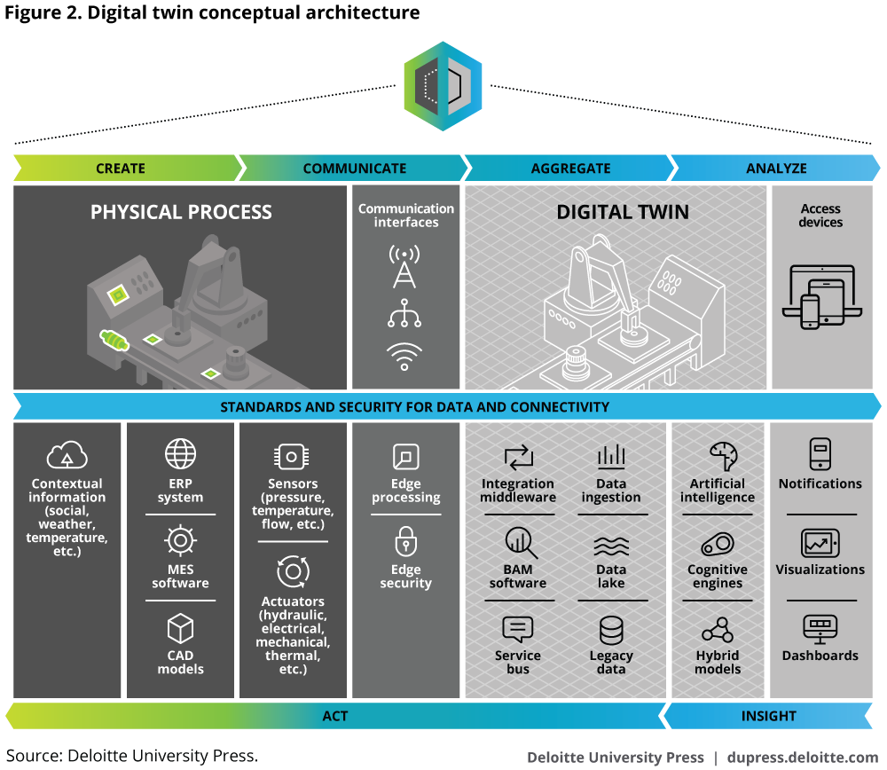
Architecture

Slide 15
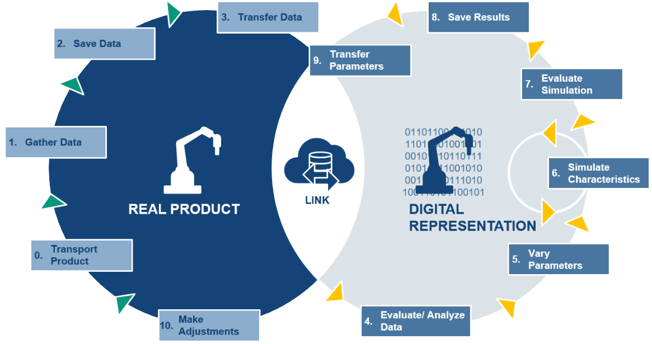
Working Of Digital Twin:
Whoa! That’s a big number, aren’t you proud?

Slide 16
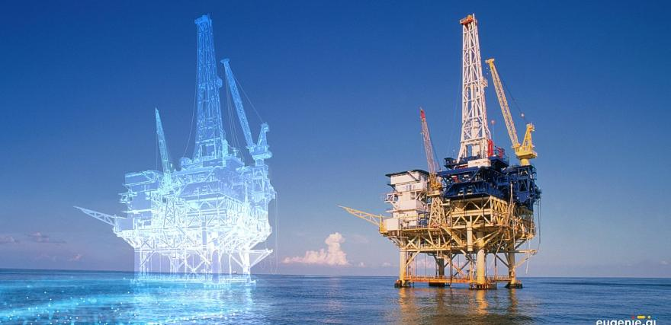
Conceptual Idea of PLM
DATA
INFORMATION
PROCESS
Real Space
Virtual Space
CONCEPT – Digital Informational Construct VISION – Create, Test, Build

Slide 17

Technology Stack
Artificial Intelligence, Machine Learning
1
Cloud Computing
Cloud stores the data and compute the data and
make it easily access it from any location
2
Nvidia Omniverse , Unity,
Unreal Engine
Omniverse - 3D simulation and design collaboration,
Unity game developement create a 3d model of the digital dam
3
Internet of Things , Sensor
Iot sensor enables constant data transmission.
4

Slide 18
Business Impact / Measure Of Success
4

Slide 19
How will the customer benefit?
Accelerated risk assessment and production time
With the help of a digital twin, companies/customer can test and validate a product before it even exists in the real world. By creating a replica of the planned production process, a digital twin enables engineers to identify any process failures before the product goes into production.
Enhanced patient experience
Optimized resource utilization
Improved clinical outcomes
Lower facility operating costs
Enhance safety
Reduce energy consumption
Real-time remote monitoring
Better financial decision-making

Slide 20
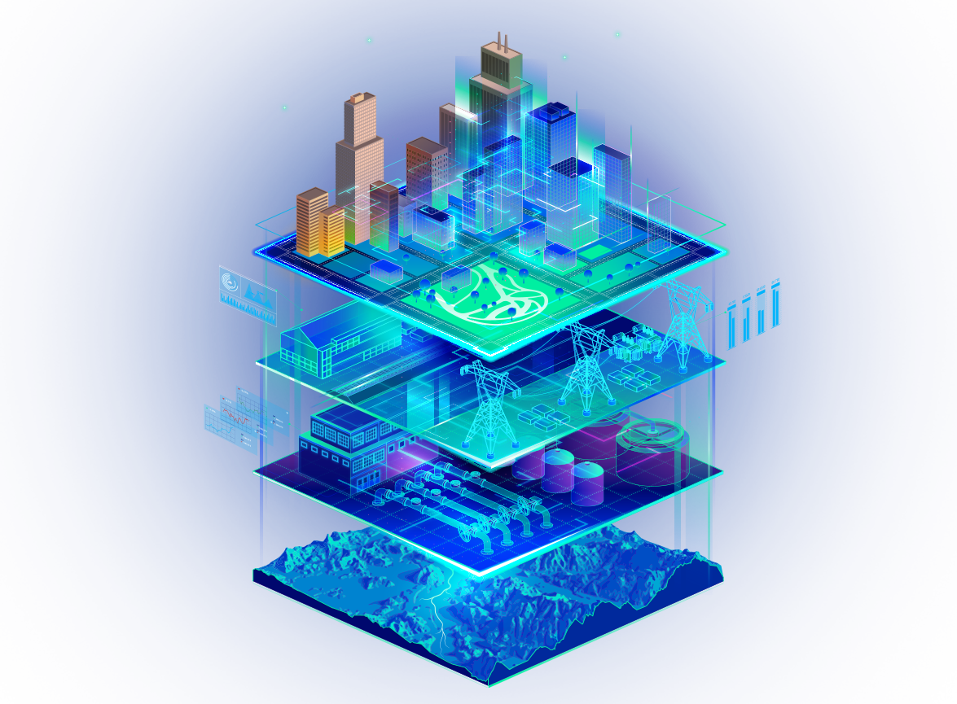
How digital twin has impacted the industry?
This digital imitation of physical assets, operations, and frameworks produces data continuously for Hospital
Digital Twin is at the core of the entire Industry 4.0 development, which enfolds automation, data exchange, and manufacturing processes, producing endless opportunities for industries to grow.

Slide 21
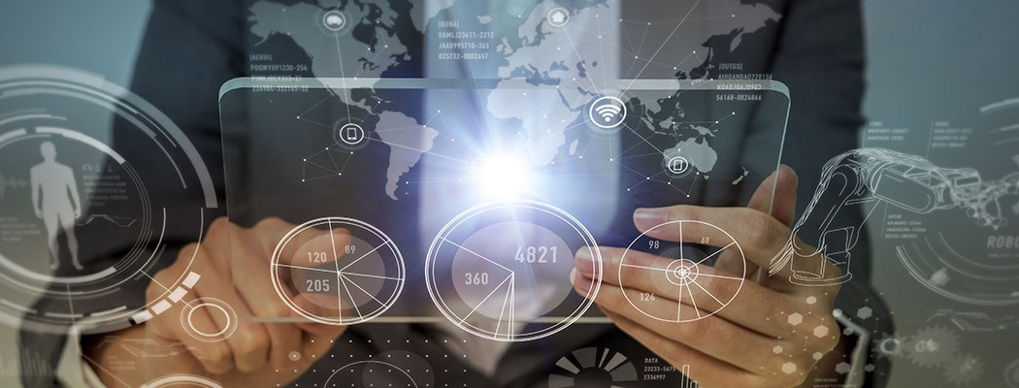
USP(unique selling point)
Scalability
In scalability we can be used as industrial/Construction purpose or for education purpose
Time To Market
All across the world's markets and industries, products are moving from conceptual design to market release So it will be soon
Cost
cost will be cheaper than other vendors.
Usable
It is a web based application so it can be used
without downloading the software.
Loads
The server will take the loads generated by the
process so does not need high end phone

Slide 22

N
THANK YOU

